Slide 1
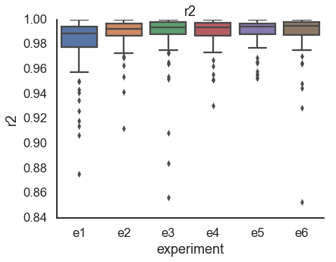
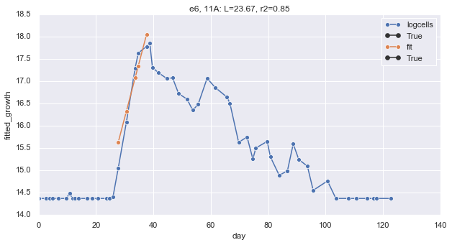
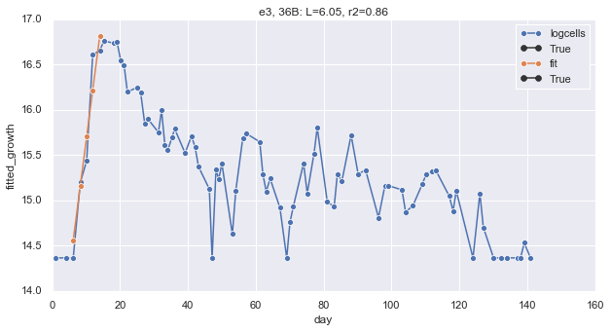
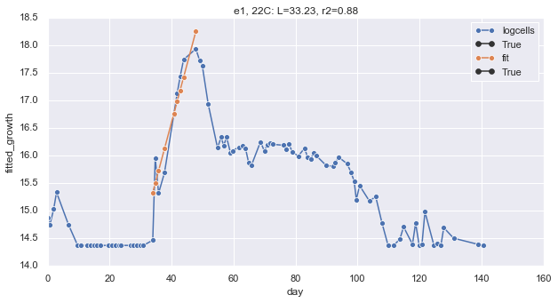
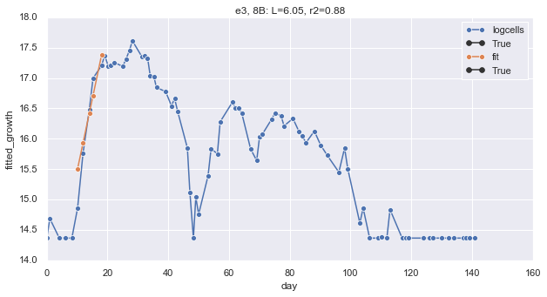
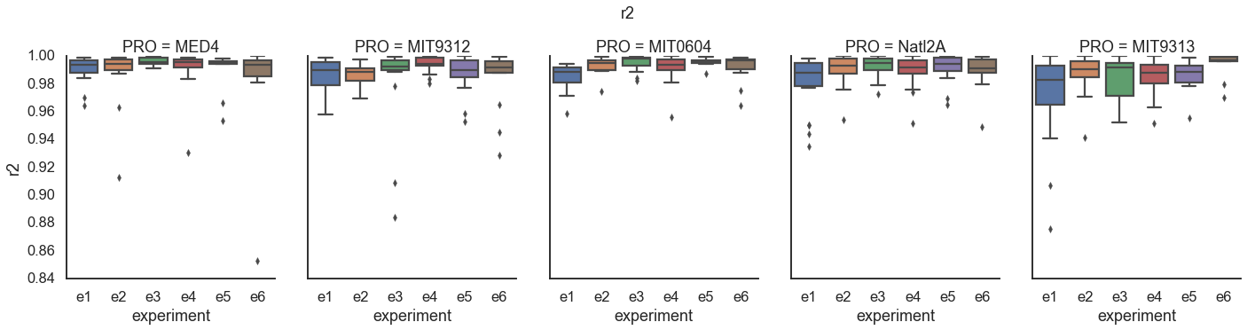
Growth
the coefficient of the linear portion of ln(cells)
Cells number from fitting to FCM on previous experiments
R² > 0.98 for most of the curves
These are all the samples with r² < 0.9

Slide 2
Lag
ln(N_{t}) = u * d + intercept
intercept = ln(N₀)
ln(N_{t}) = u * d + ln(N₀)
d = (ln(N_{t}) - ln(N₀)) u + L
L = d - (ln(N_{t}) - ln(N₀)) u

Slide 3
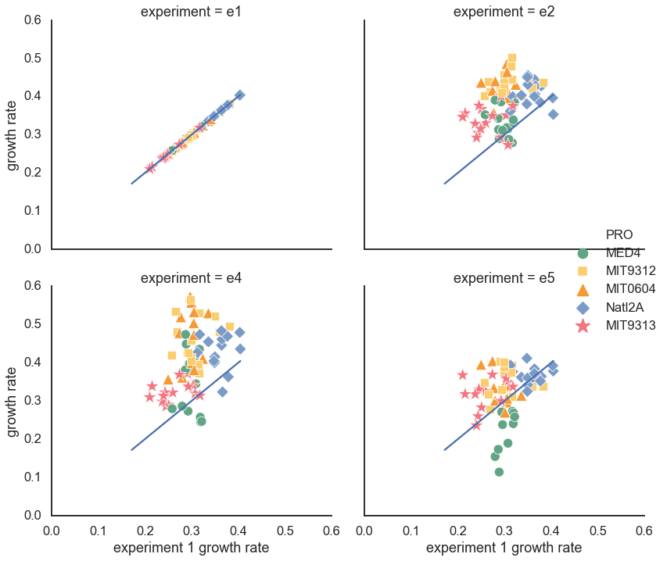
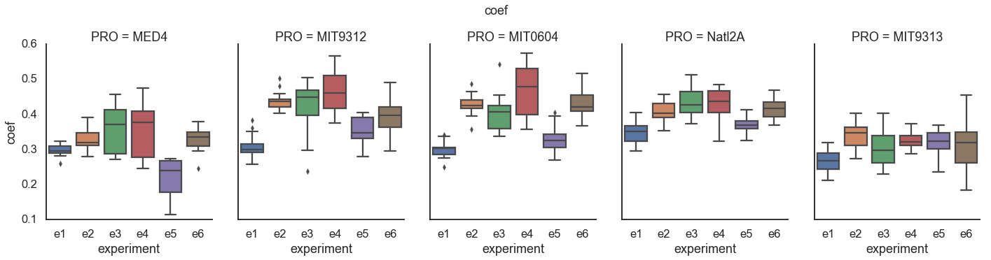
Growth rates
Most strains grow faster after transfer
MED4 grows slower, especially in e5 and e4(?)

Slide 4
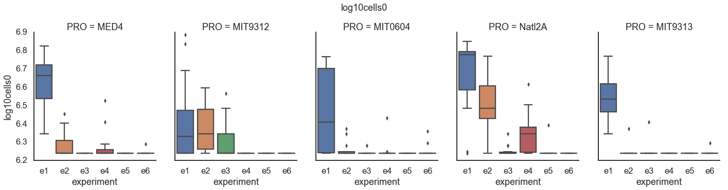
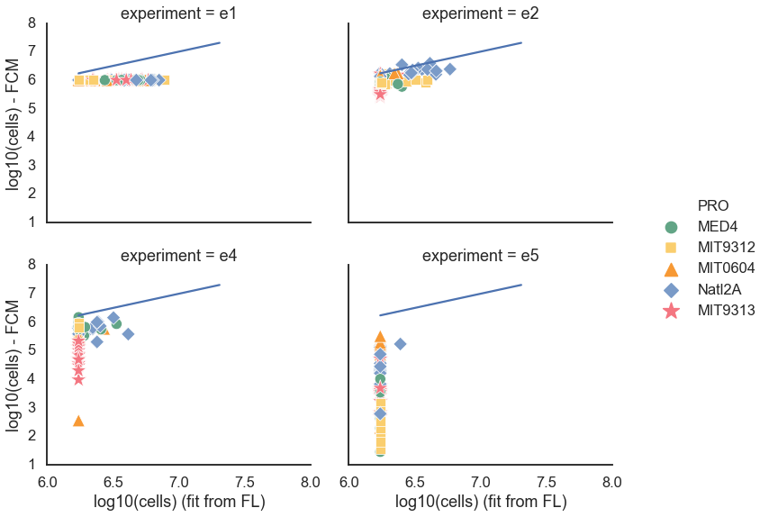
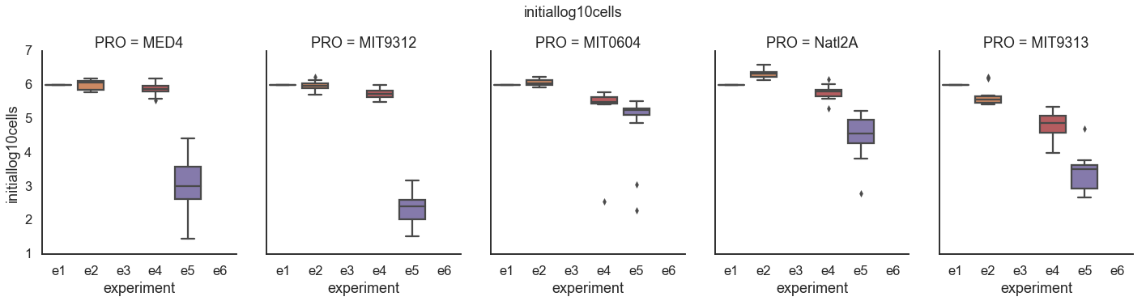
Initial cell number
Experiment 1 = 10⁶
Experiment 2 = e1 FCM @ 60 / 20
Experiment 4 = e1 FCM @ 100 / 20
Experiment 5 = e1 FCM @ 140 / 20
Fit from FL is underestimation in low FL values
Fit from FL
FCM numbers

Slide 5
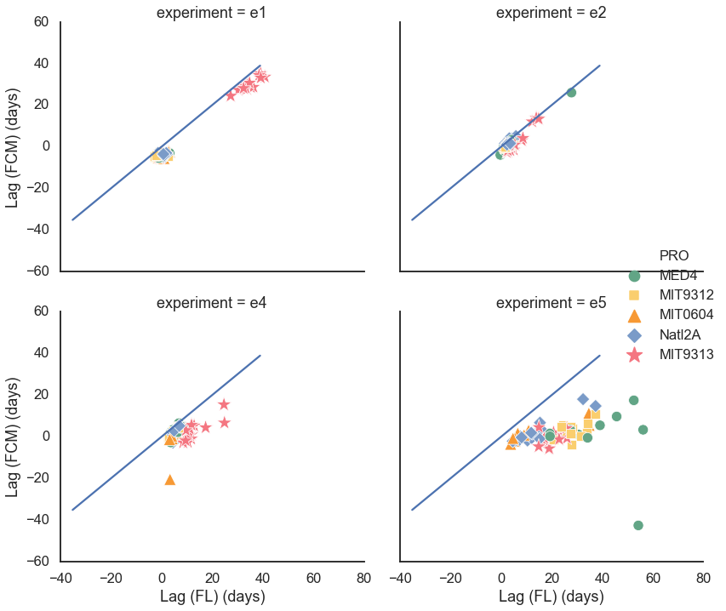
Fit from FL is underestimation in low FL values
Lag based on FL is higher than lag based on FCM
L = d - (ln(N_{t}) - ln(N₀)) u

Slide 6
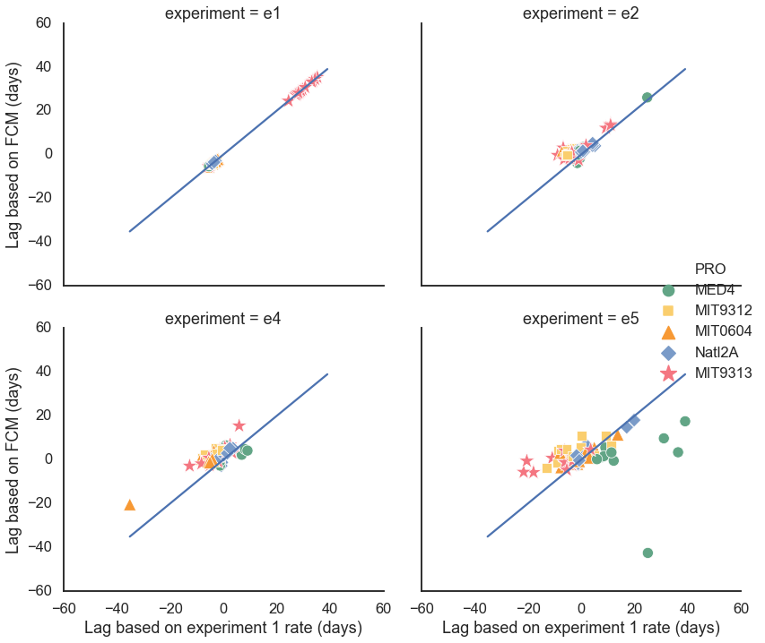
Lags
Using growth rate from current experiment
and initial cells from FCM
L = d - (ln(N_{t}) - ln(N₀)) u
Using growth rate from e1
And initial cells from FCM

Slide 7
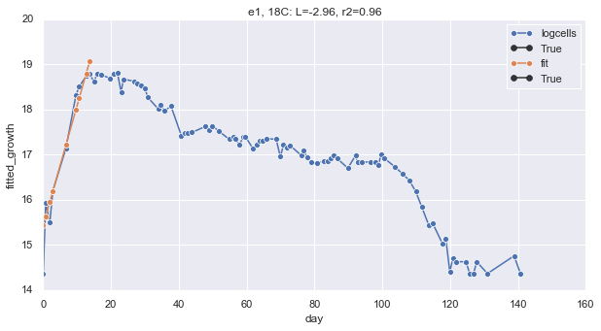
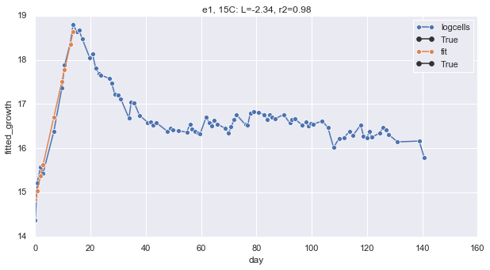
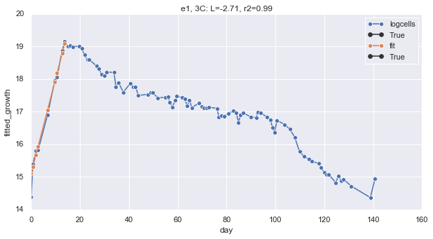
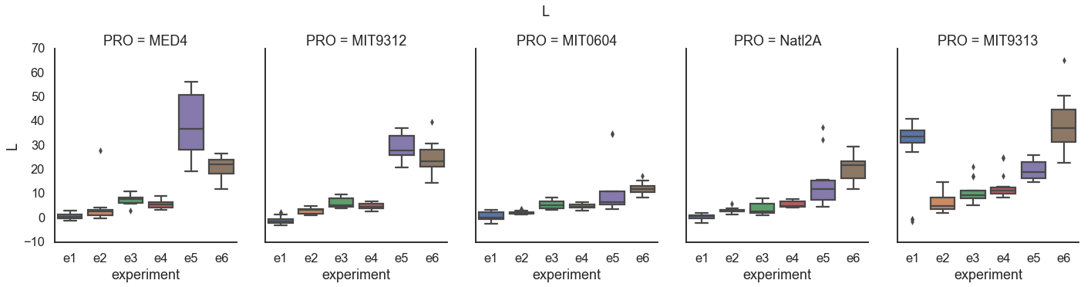
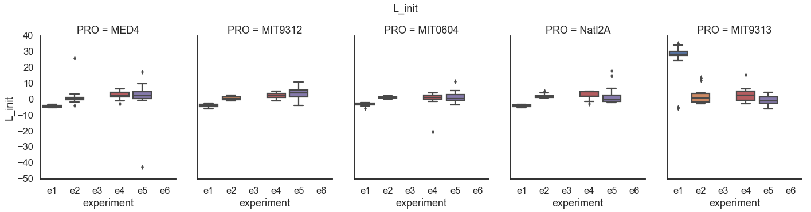
Some samples have negative lag.
Mostly experiment1
Lag based on FL
Lag based on FCM
L = d - (ln(N_{t}) - ln(N₀)) u

Slide 8
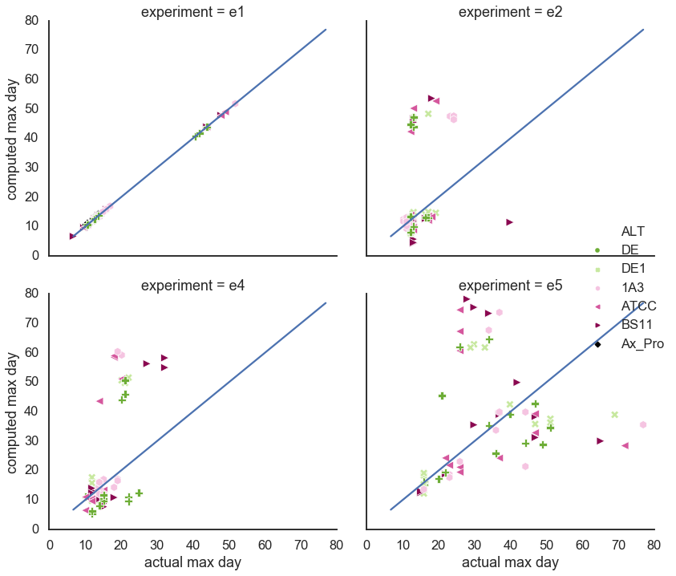
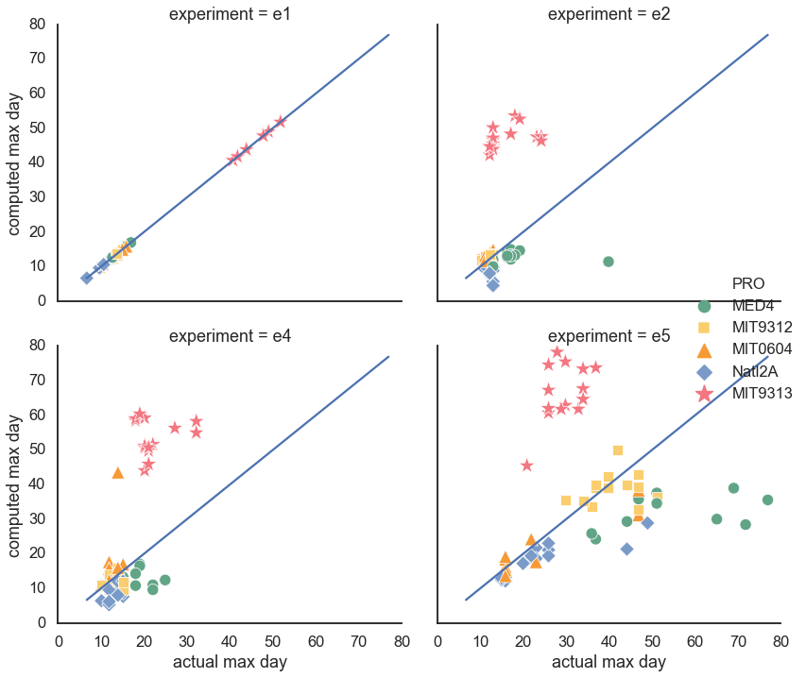
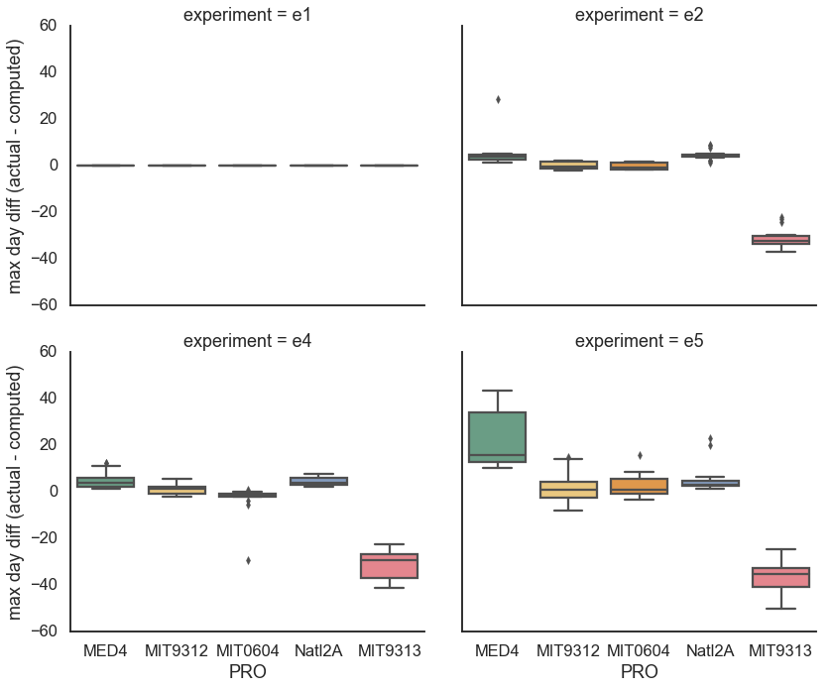
Max day
Using FCM cell numbers,
e1 growth rate, e1 Lag
Day with max FL measurement
d = (ln(N_{t}) - ln(N₀)) u + L

Slide 9
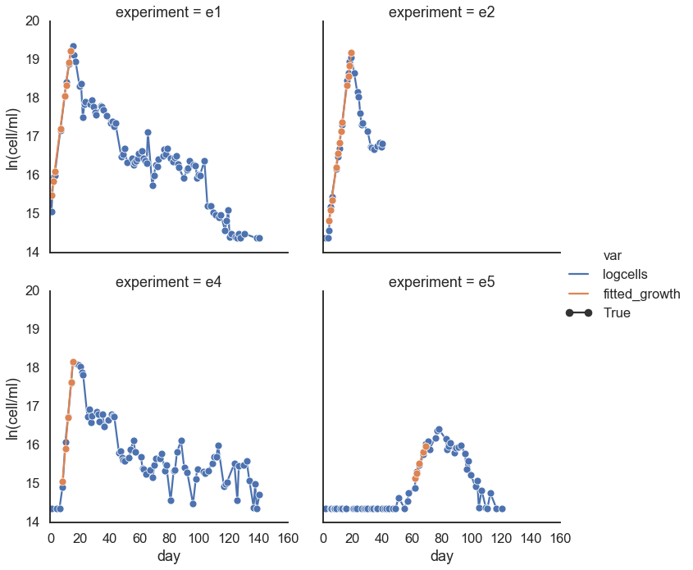
Example of delayed growth: MED4 & DE1
experiment | Log10 initial cells FL | Log10 initial cells FCM | Growth rate | r² | L (FL) | L (FCM) | L (FCM, e1 rate) | Max day | Max day based on e1 rate and lag
e1 | 6.72 | 6 | 0.29 | 1 | 0.66 | -5.1 | -5.1 | 13.69 | 13.69
e2 | 6.24 | 5.81 | 0.29 | 0.99 | 2.96 | -0.48 | -0.54 | 19.2 | 14.64
e4 | 6.24 | 5.95 | 0.45 | 0.99 | 6.73 | 5.24 | -0.27 | 15.14 | 10.31
e5 | 6.24 | 1.45 | 0.11 | 0.95 | 54.26 | -42.67 | 24.95 | 69.01 | 38.96

